Slide 1
Modeling Precipitation in the Northeast United States
Lori Fomenko

Slide 2
Outline
Objectives of this project
Data sources and types of data used
Models and Methodology
Key Results
Challenges
Conclusions and Further Research

Slide 3
Objectives
Are there significant differences between individual stations within cities and/or between individual stations and the citywide average?
Do major cities like Boston and NYC get significantly more annual precipitation than the Northeast region or Tri-State area on average?
How do GCMs compare to observations in representing historical annual precipitation amounts?
Is annual precipitation expected to increase in the future under the current emission scenario (RCP 8.5)?
How well are GCMs and RCMs able to capture individual events?

Slide 4
Source and Type of Data
Land-based Station data from Global Historical Climatological Network Database for individual stations in NYC and BOS
Source: Mapping Tool for daily Precipitation available at https://gis.ncdc.noaa.gov/maps/ncei/cdo/daily
Gridded surface meteorological observational dataset (MetData)
Source: (http://metdata.northwestknowledge.net/)
Key Details
Training data for downscaling GCM output to macav2-metdata product
4 km (1/24 deg) spatial resolution, daily timescale
Bias-corrected mesoscale reanalysis and assimilation data
Validated against various station networks (RAWS,Agrimet,AgWeatherNet, and USHCN-2)

Slide 5
Models
Macav2-Metdata product for downscaled GCM output
Historical runs (1991-2005) and future projections (2041-2060)
Models included for historical projections (1991-2005): CCSM4, CNRM-CR5, GFDL-ESM2M, HadGem2-ES365, MRI-CGCM3, NorESM1M,MIROC5,and MIROC-ESM
Model used for bias-corrected future projection: CCSM4, r6i1p1 ensemble used for MACA downscaling from (1.25 deg x 0.94 deg) to 4 km resolution
Source: MACA Data Portal (http://maca.northwestknowledge.net/data_portal.php)
RCM output
RCM3 model run
Precipitation output from Atmospheric Model (ATM) and Land Surface Model (SRF)
NNRP2: NCEP reanalysis dataset used for ICBCs (2.5 degree grid resolution)
LAMCON Projection and 60 km grid spacing
Modeled over all study domains, but centered at clat = 42 and clon = -73

Slide 6
Methodology
Domains
Area | Lat Bounds(min, max) | Lon Bounds (min, max) | RegCM B.C.s (lat,lon)
Northeast Region | 37, 48 | -79,-67 | Same
Tri-State Area | 38.7,43.5 | -75.3,-70.3 | Same
Boston | 42.18,42.57 | -71.19,-70.98 | (41.9,42.9), (-71.6,-70.6)
NYC | 40.47,40.94 | -74.11,-73.68 | (40.4,41.4), (-74.5,-73.5)

Slide 7
Methodology
Objective 1
Select desired stations in BOS and NYC and download GHCN station data (1997-2016). Quality control of data, look for missing data (days, months, years, etc.). Choose stations with continuous data throughout period.
Determine matching grid cell in gridded MetData dataset, and average the precipitation values over that grid cell to get one representative point.
Compare GHCN station data with grid-averaged MetData at daily timescale, and isolate one year to compare trends at daily timescale. If MetData effectively captures observed precipitation, use MetData for comparison between stations.
Determine if any significant differences exist between individual stations and between individual stations and the city average across a grid containing all stations by conducting ANOVA analysis.

Slide 8
Methodology
Objective 2
Define boundaries for all four study domains and find annual averages for each.
Plot annual average precipitation over 1991-2005 (same years as GCM runs)
Conduct ANOVA analysis between regions to determine if any differences between the means are significant
Objective 3
Compare historical GCM runs output with MetData for 1991-2005, area-averaged annual precipitation with the same boundaries for each study domain
If no obvious correlation in interannual precipitation variability, choose one GCM for bias correction.
Objective 4
Choose GCM (CCSM4) and correct bias based on difference between historical model projection and observed precipitation (1991-2005) for each domain
Plot historical GCM run and bias-corrected GCM output, and future model projection and future bias-corrected GCM projection (2041-2060)

Slide 9
Methodology
Objective 5
Choose event within time period (1991-2005) to investigate.
Run RCM3 from 2005100700 to 2005101200
Compare resulting precipitation patterns and average precipitation per 3 hour increment and daily for both ATM and SRF output over all study areas
Compare RCM output with observations over period (daily) for all domains
Compare GCM output with observations over period (daily) for all domains
iproj | LAMCON | Map projection
iy | 74 | # grid points in y direction
jx | 85 | # grid points in x direction
ds | 60.0 | Grid point separation (km)
clat | 42 | Central latitude of domain (deg)
clon | -73 | Central longitude of domain (deg)
ntypec | 10 | Resolution of the global terrain and land-use data
IDATE1 | 2005100700 | Simulation start date
IDATE2 | 2005101200 | Simulation end date
SSTTYP | OI_WK | SST dataset
DATTYP | NNRP2 | Global analysis dataset

Slide 10
Key Results
Are there significant differences between individual stations within cities and/or between individual stations and the citywide average?

Slide 11
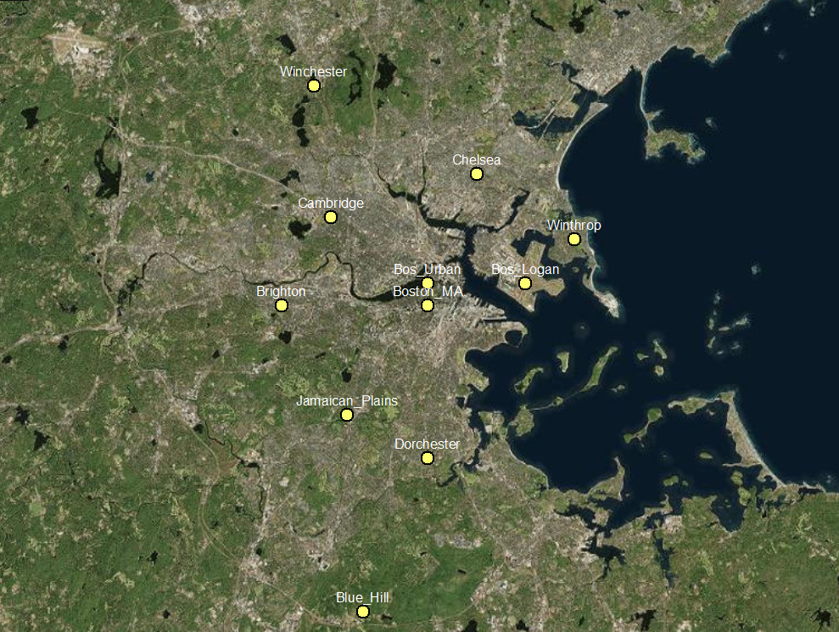

Slide 12
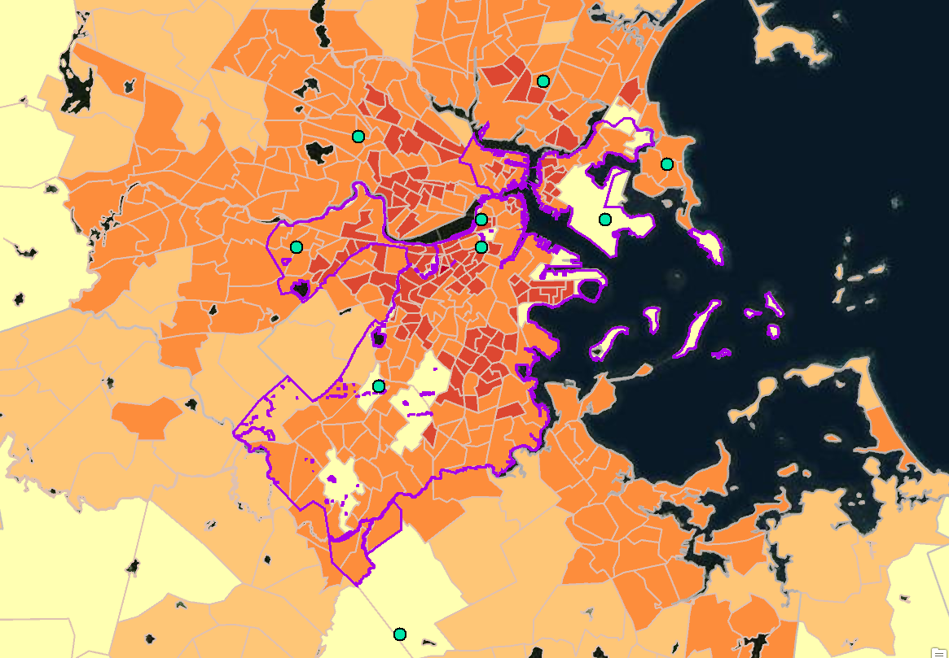

Slide 13
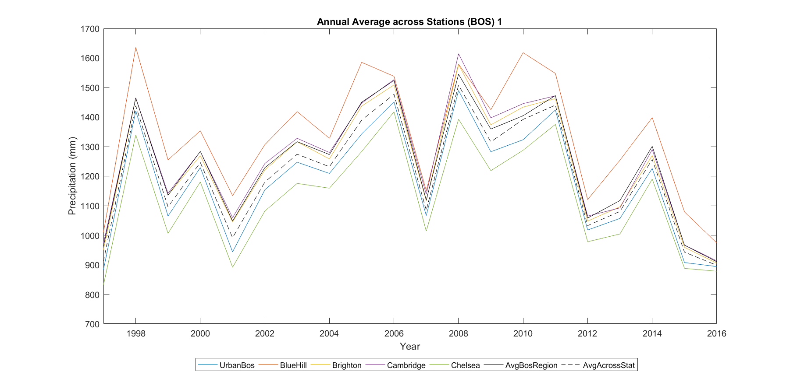
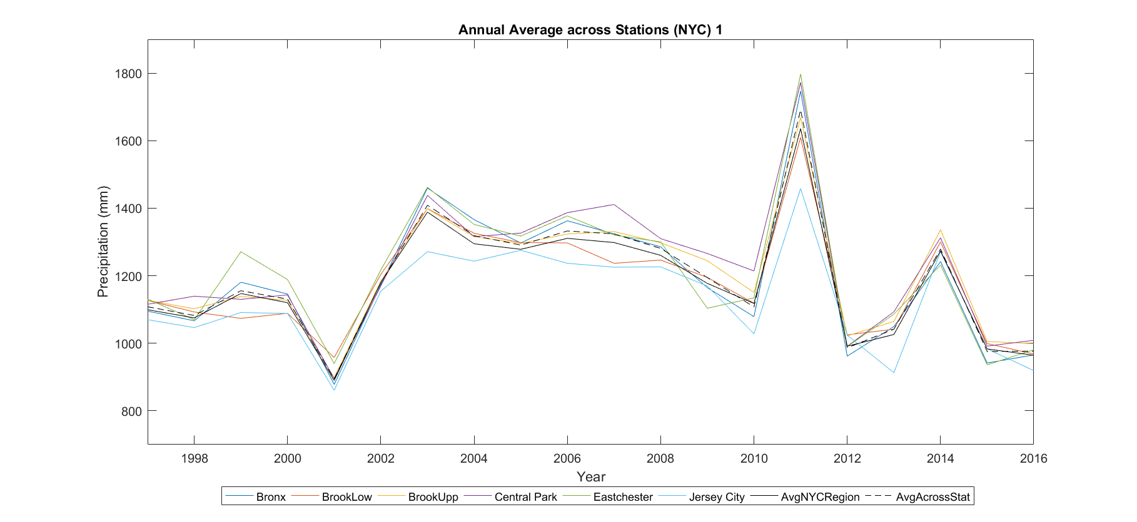
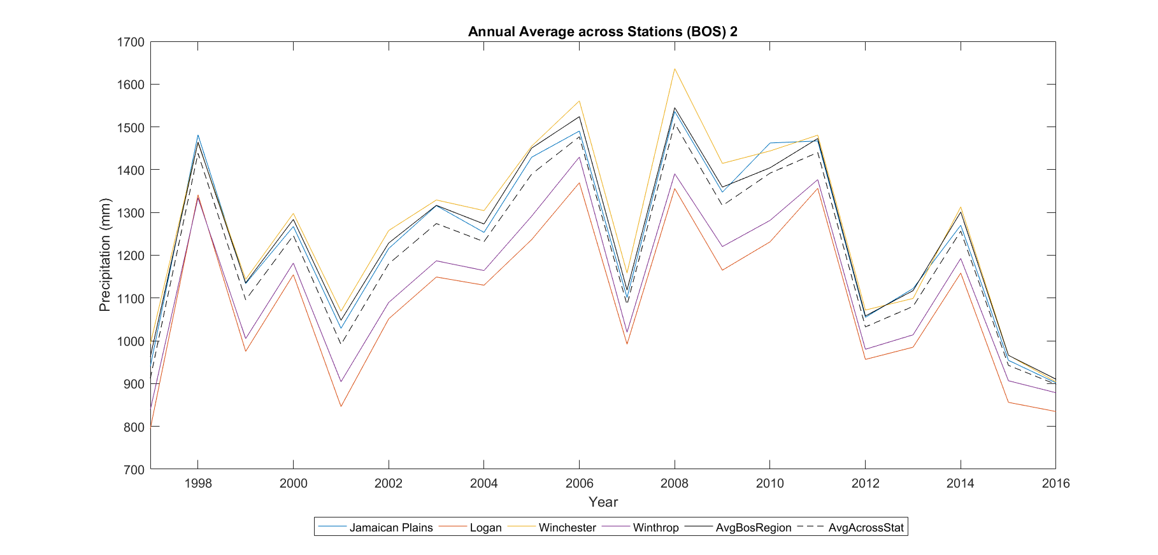
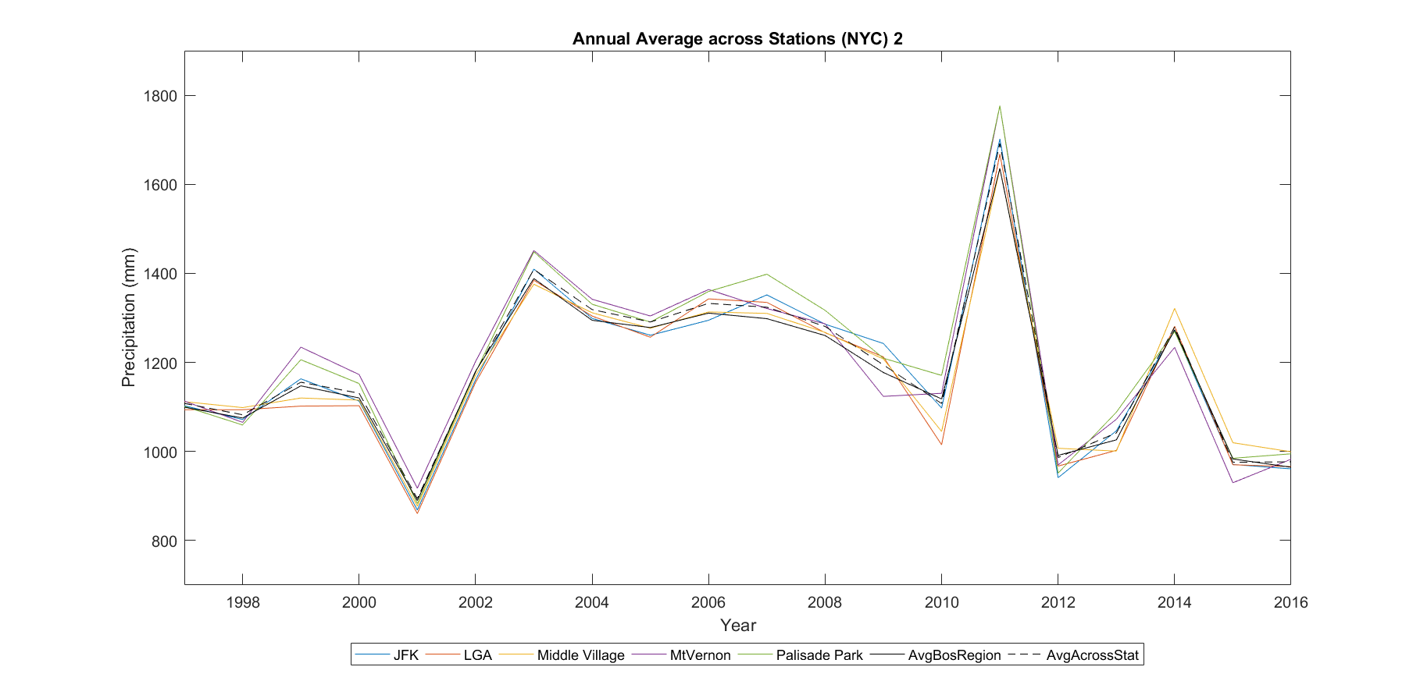

Slide 15
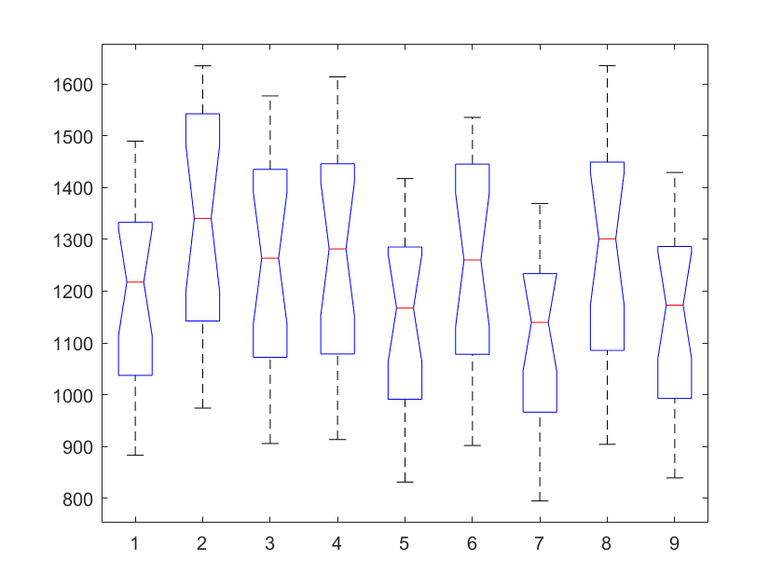
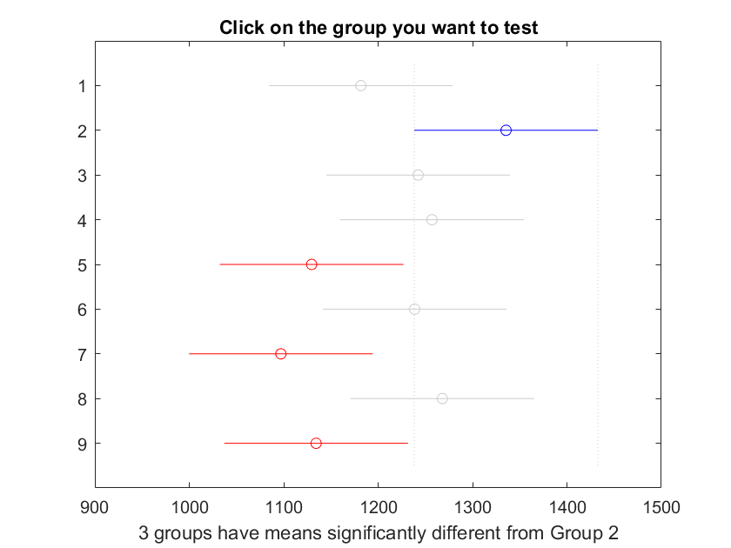
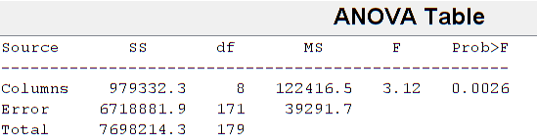
1 | 2 | 3 | 4 | 5 | 6 | 7 | 8 | 9
UrbBos | BlueHill | Brighton | Cambridge | Chelsea | Jamaican Plains | Logan | Winchester | Winthrop

Slide 16
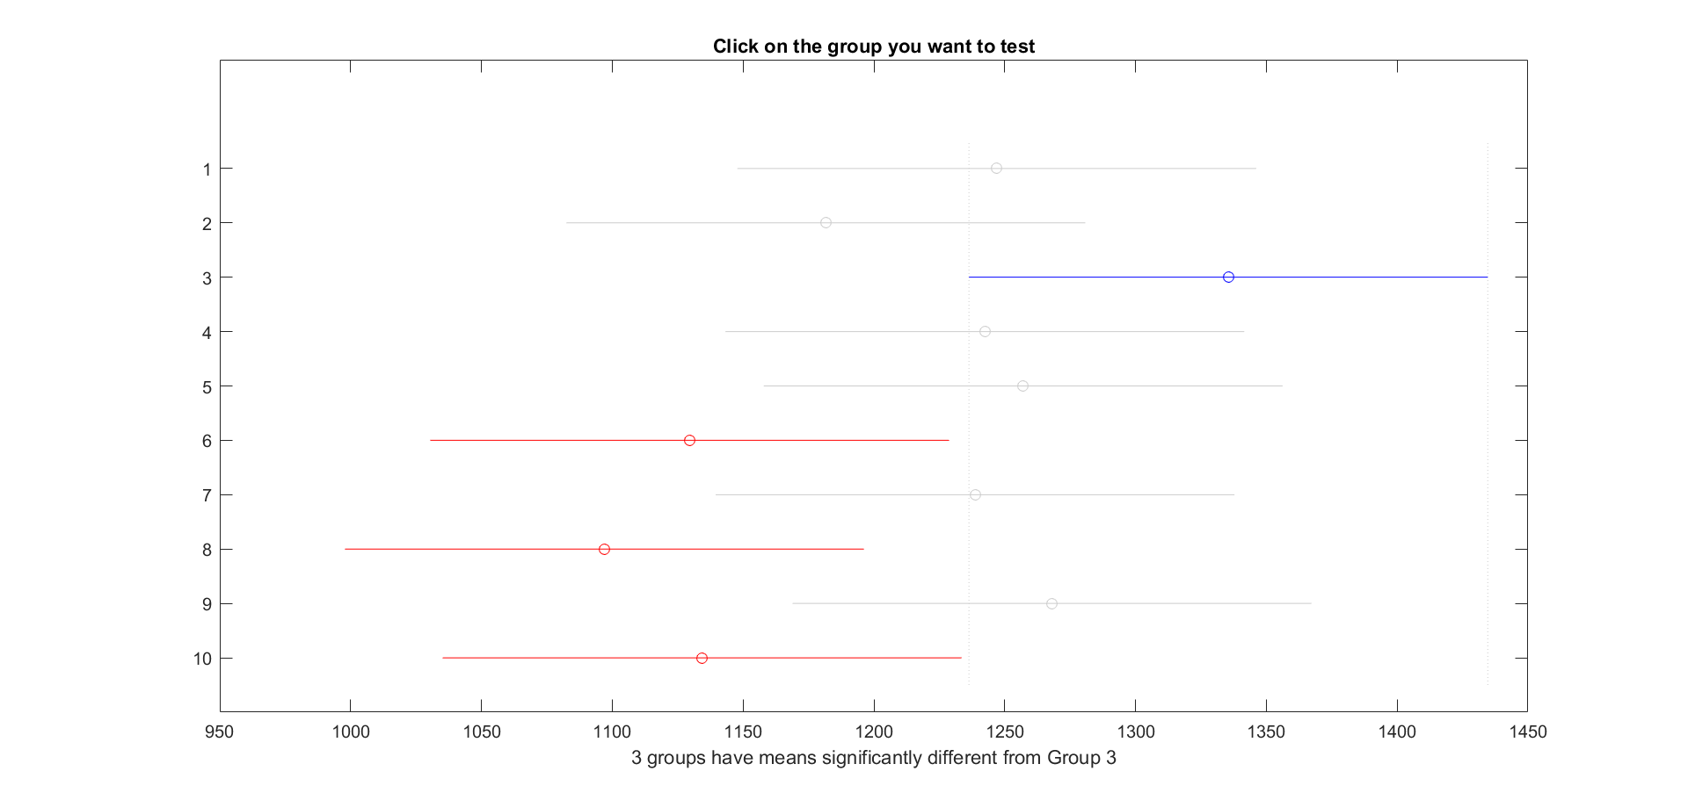
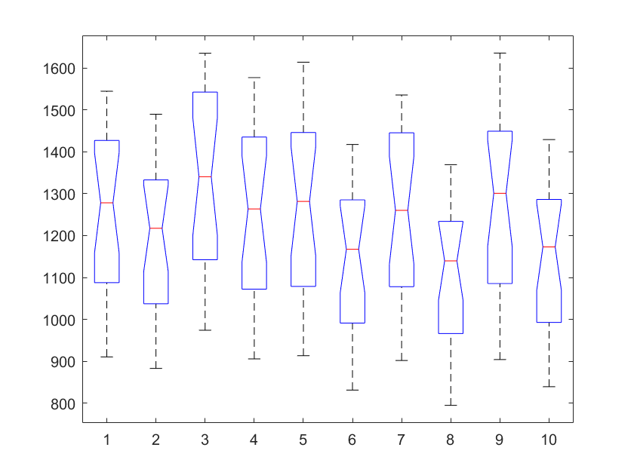
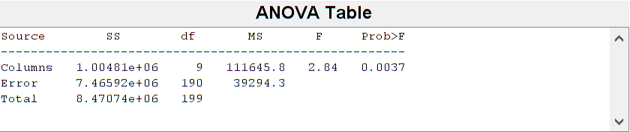
1 | 2 | 3 | 4 | 5 | 6 | 7 | 8 | 9 | 10
Bos Region | UrbBos | BlueHill | Brighton | Cambridge | Chelsea | Jamaican Plains | Logan | Winchester | Winthrop

Slide 17
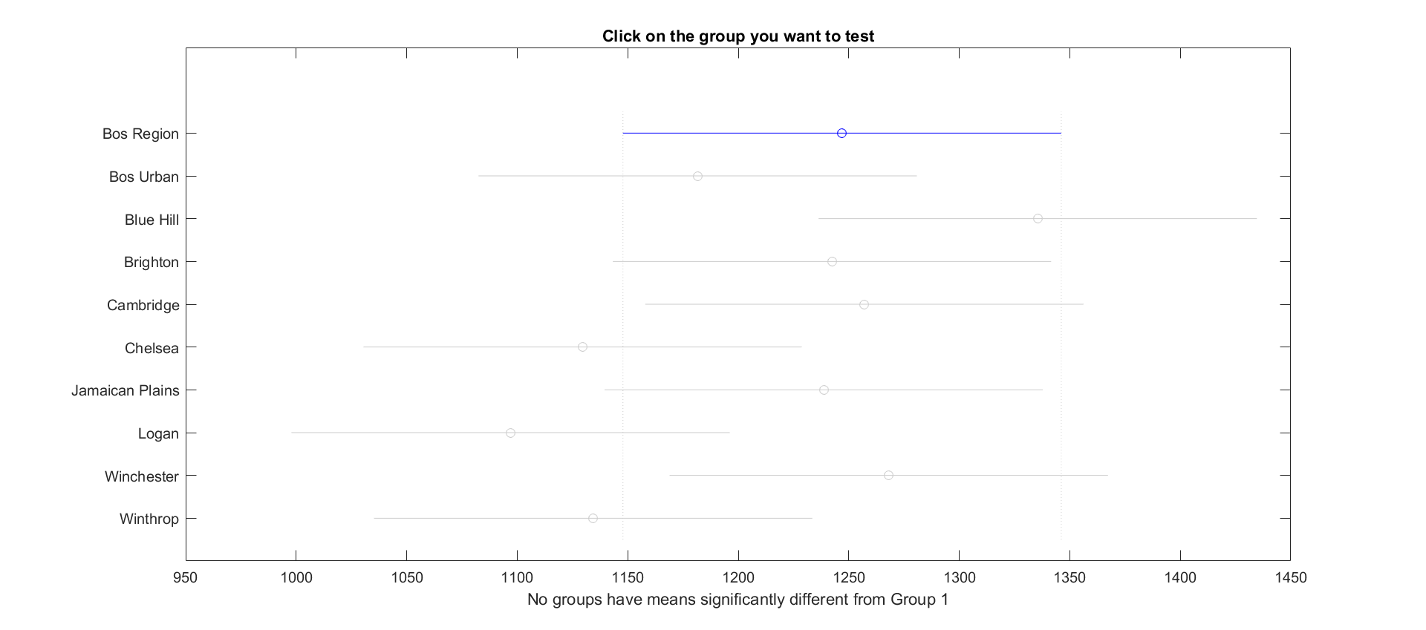
1 | 2 | 3 | 4 | 5 | 6 | 7 | 8 | 9 | 10
Bos Region | UrbBos | BlueHill | Brighton | Cambridge | Chelsea | Jamaican Plains | Logan | Winchester | Winthrop

Slide 18
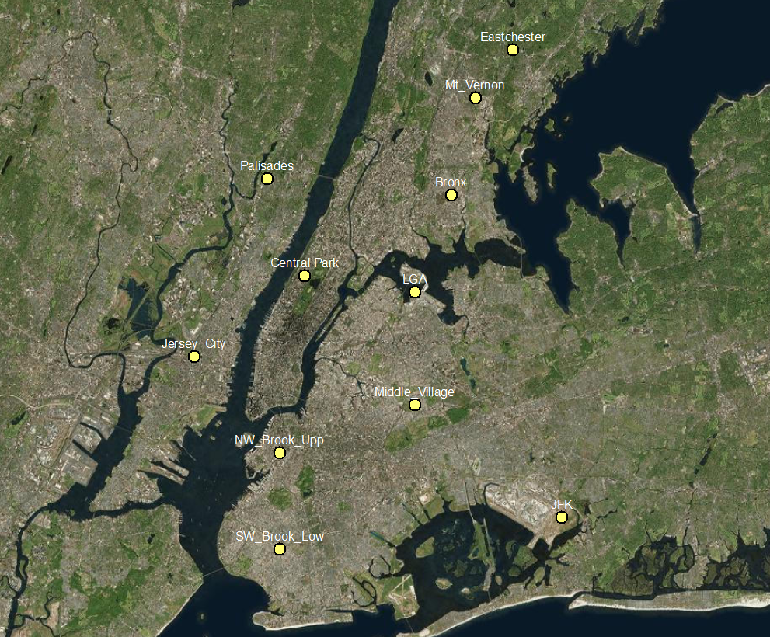

Slide 19
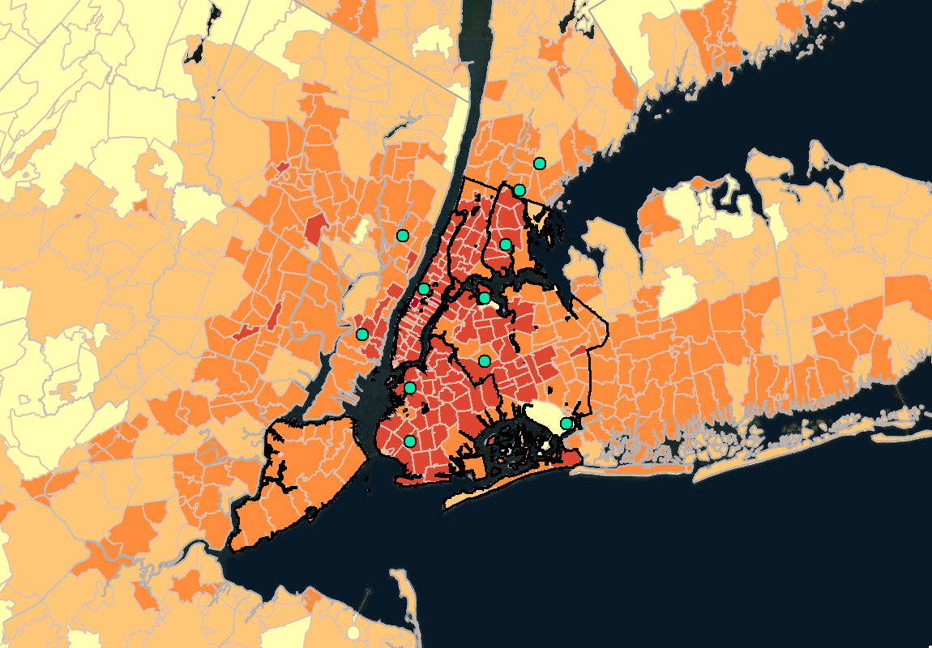

Slide 22
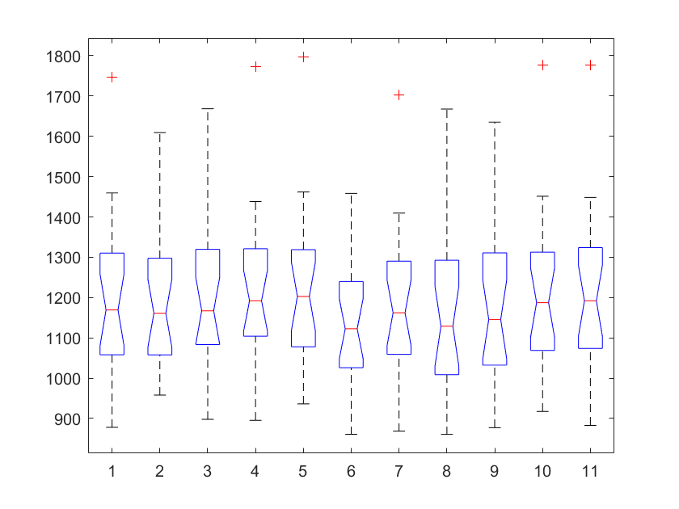
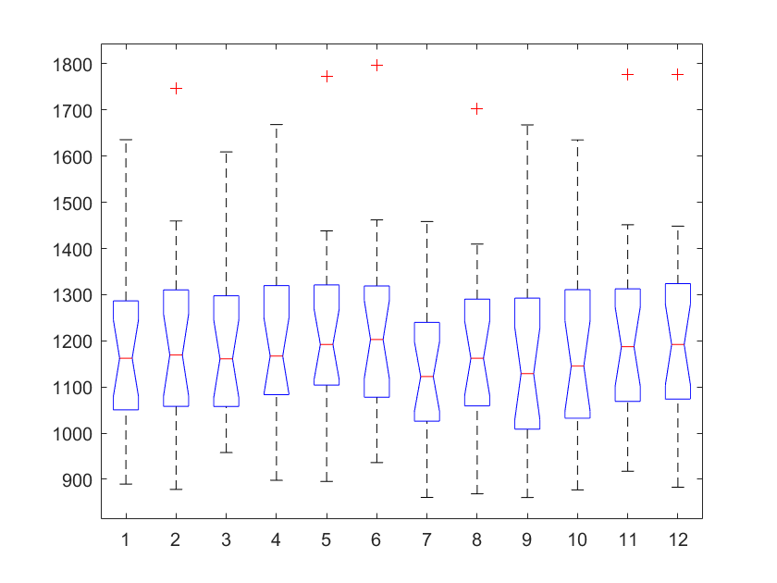
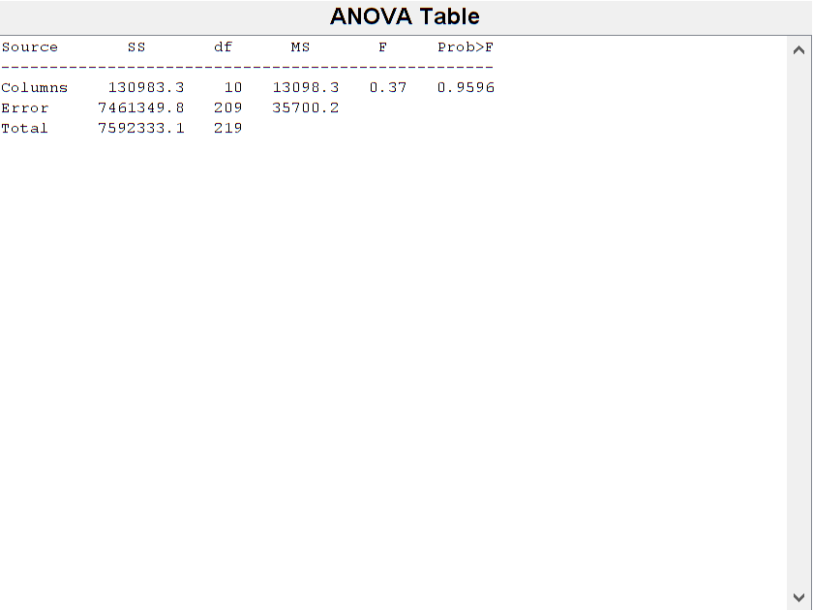
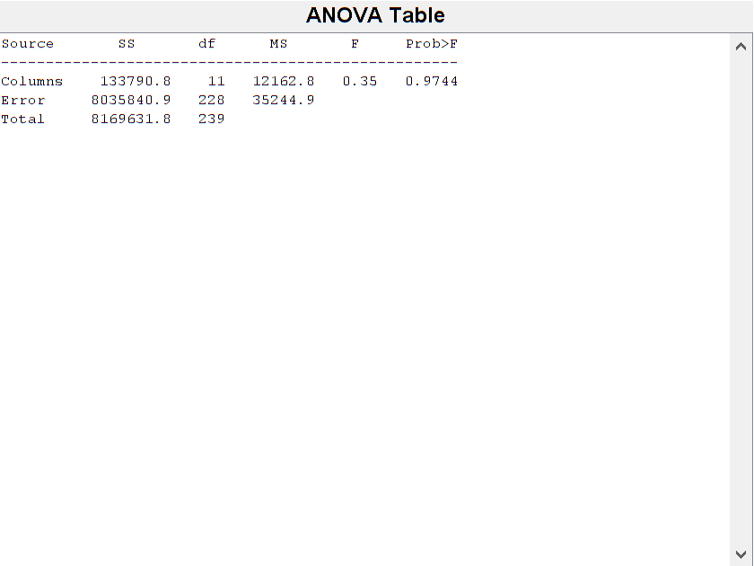
1 | 2 | 3 | 4 | 5 | 6
Bronx | BrooklynLower | BrooklynUpper | Central Park | Eastchester | Jersey City
7 | 8 | 9 | 10 | 11
JFK | LGA | Middle Village | Mt Vernon | Palisades
1 | 2 | 3 | 4 | 5 | 6
NYC Region | Bronx | BrooklynLower | BrooklynUpper | Central Park | Eastchester
7 | 8 | 9 | 10 | 11 | 12
Jersey City | JFK | LGA | Middle Village | Mt Vernon | Palisades

Slide 23
Key Results
Do major cities like Boston and NYC get significantly more annual precipitation than the Northeast region or Tri-State area on average?

Slide 24
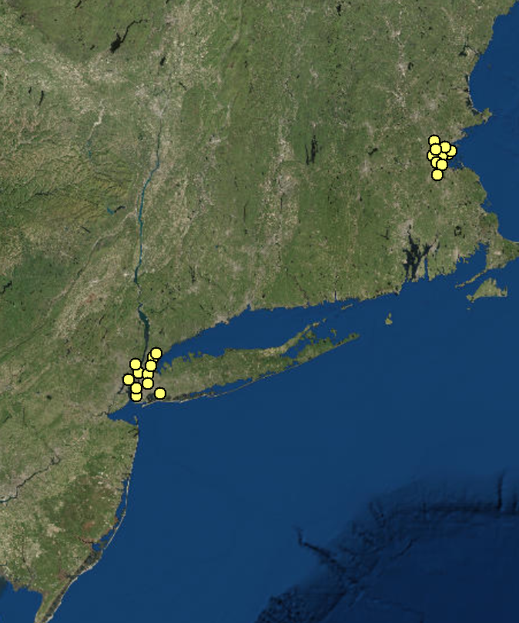

Slide 25
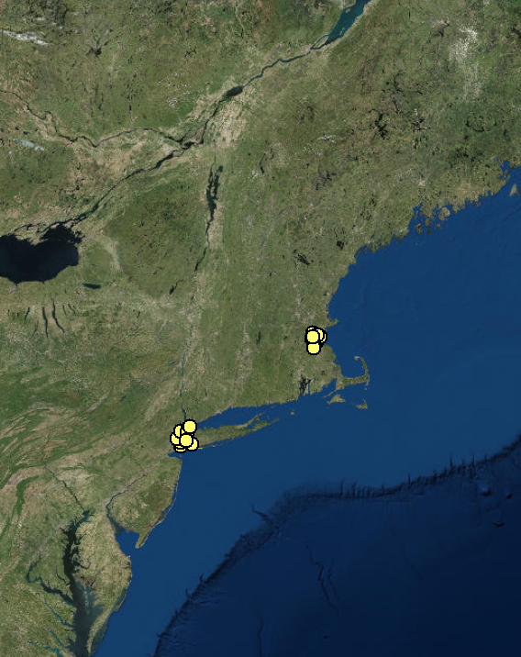

Slide 26
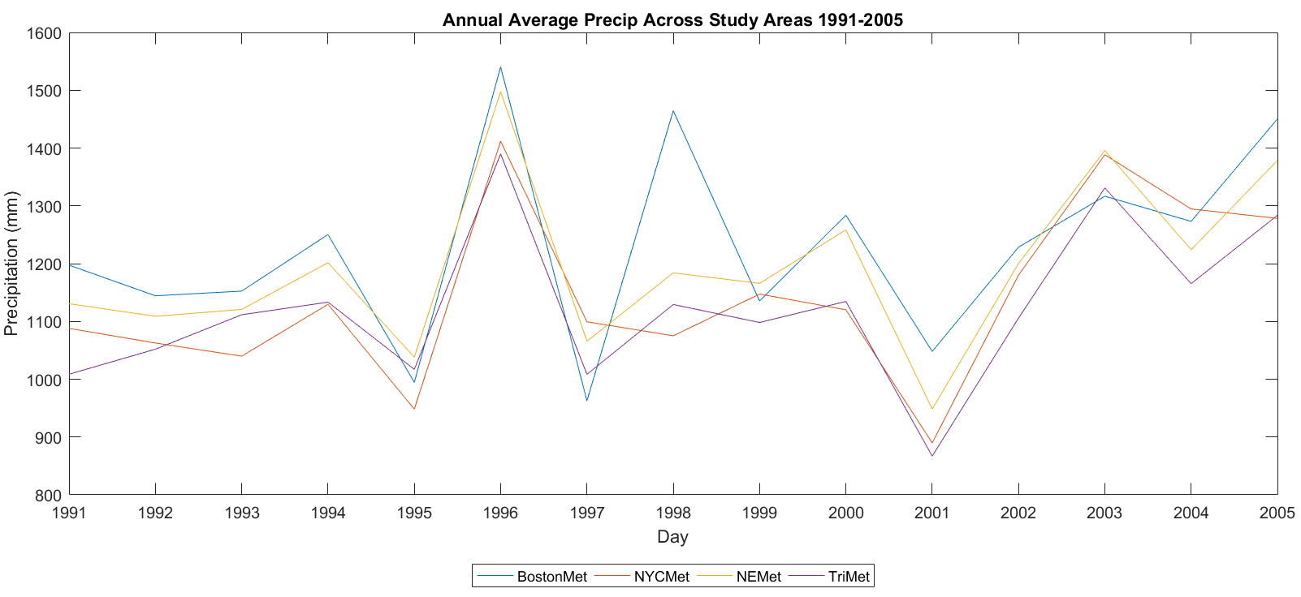

Slide 27
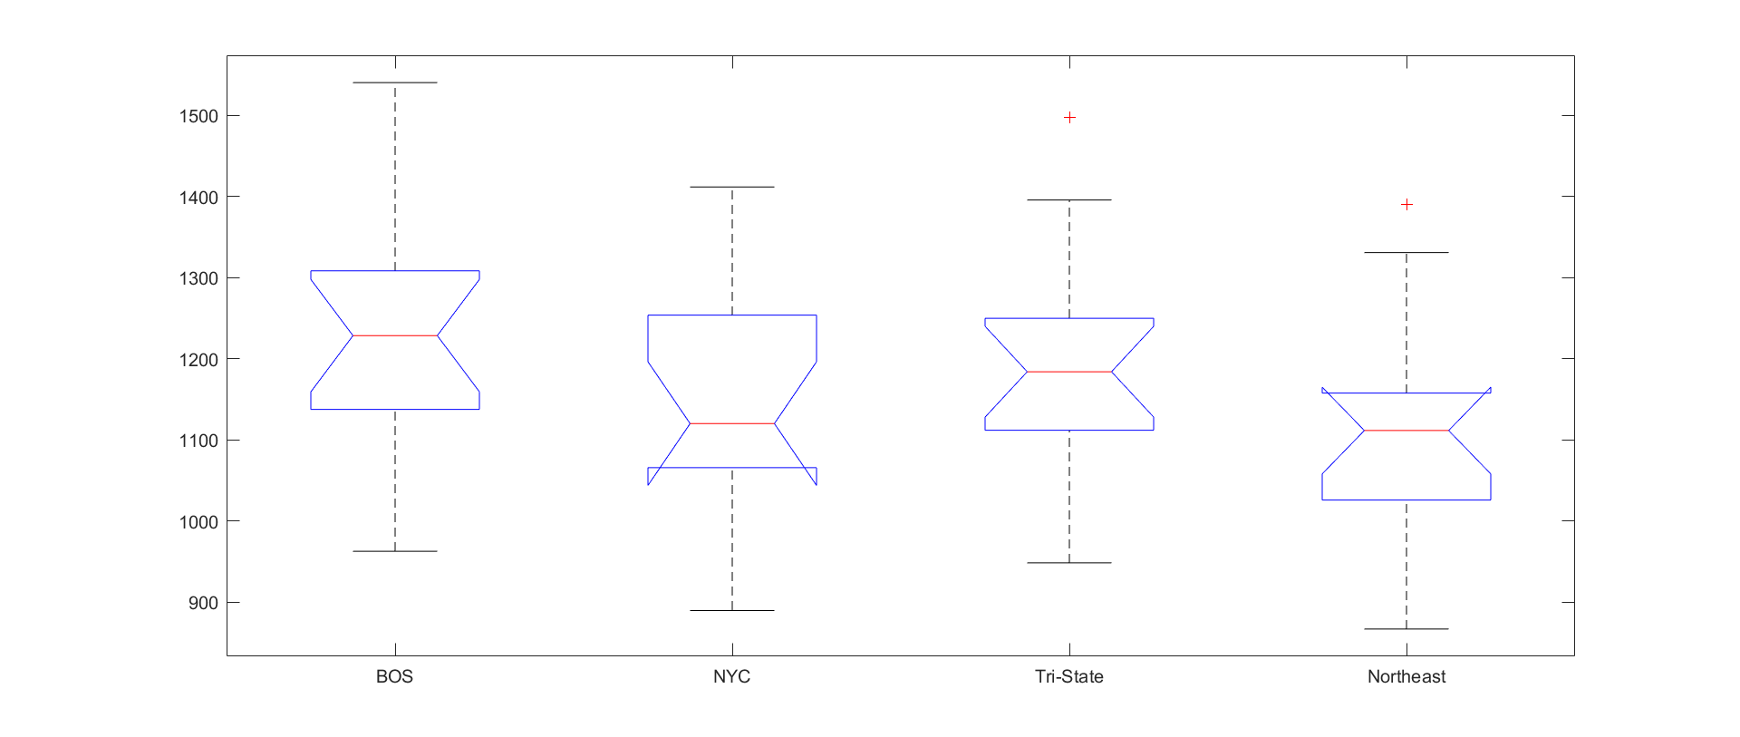
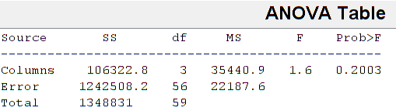

Slide 28
Key Results
How do GCMs compare to observations in representing historical annual precipitation amounts?

Slide 29
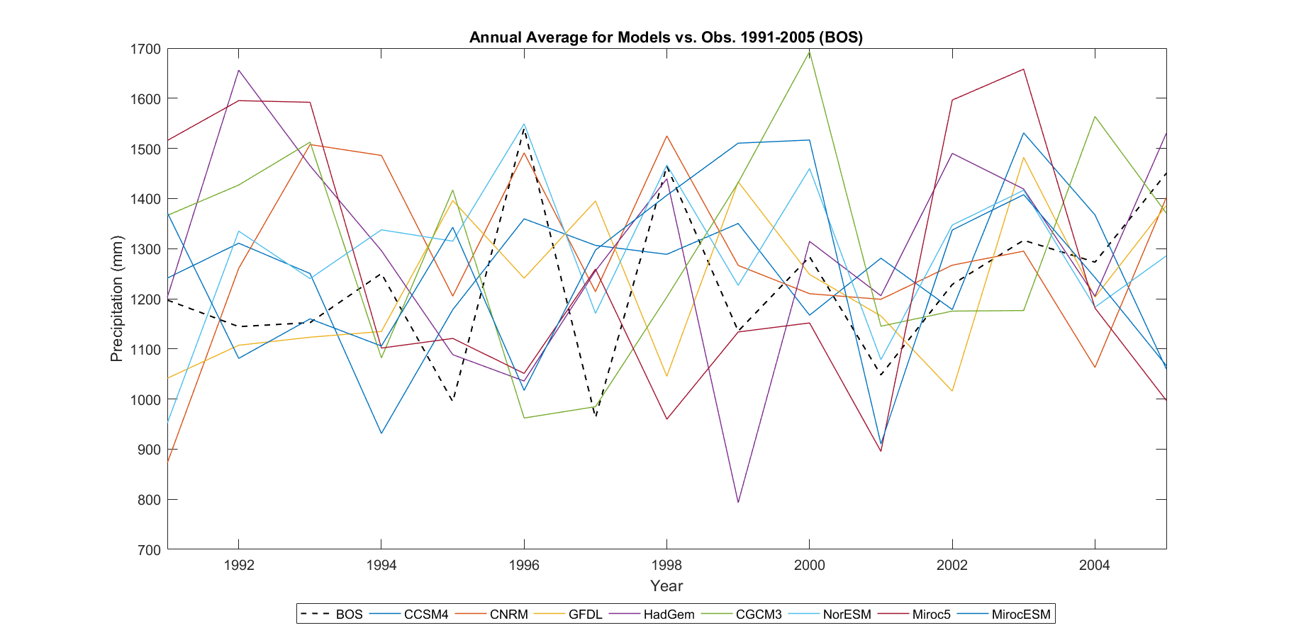
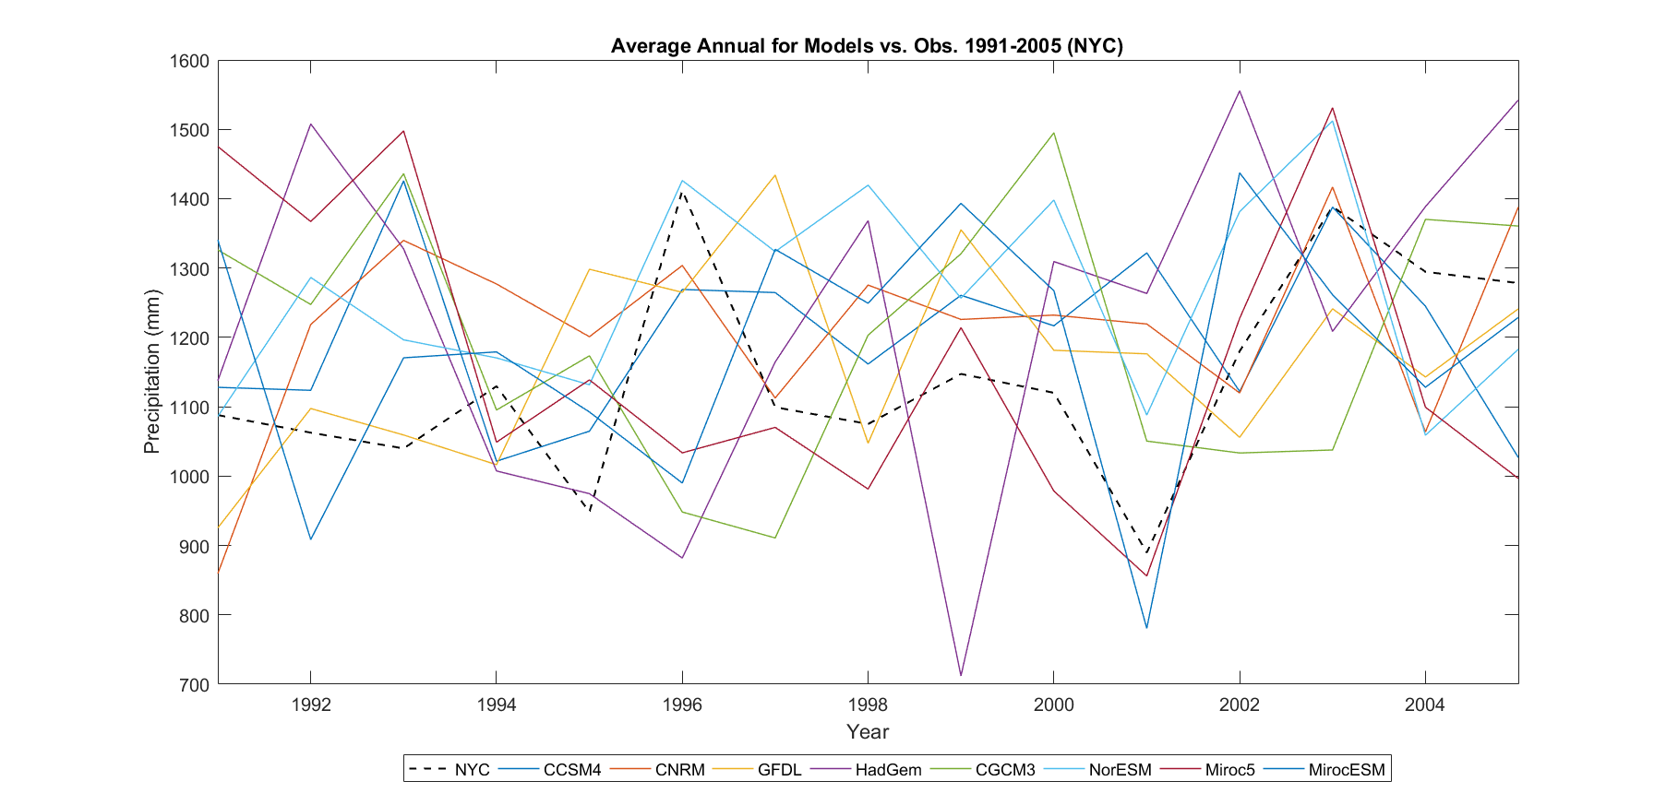

Slide 30
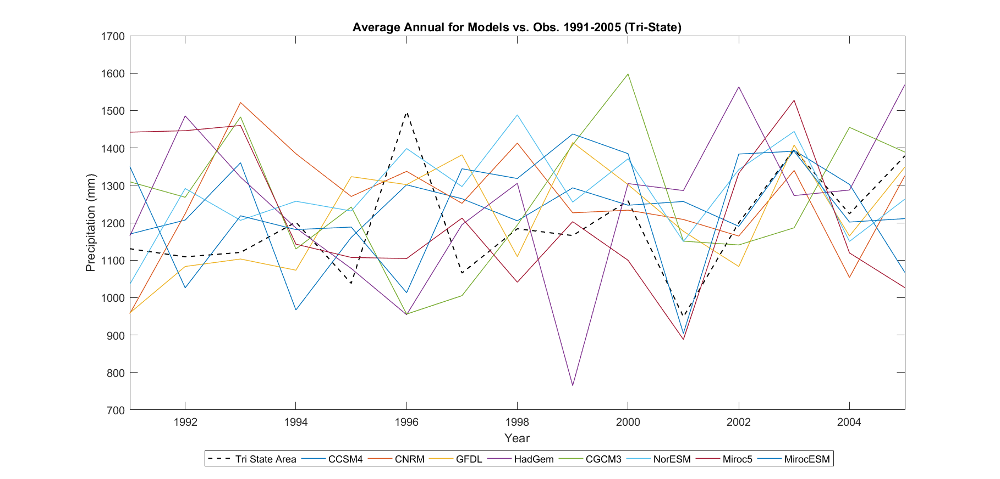
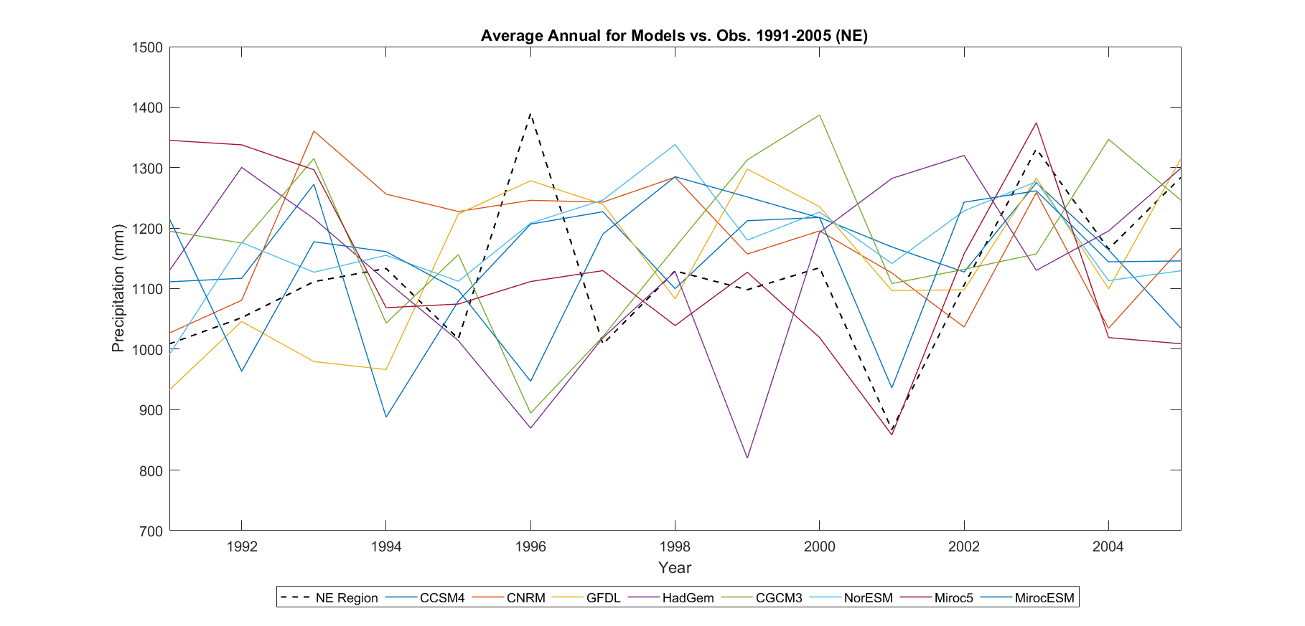

Slide 31
Key Results
Is annual precipitation expected to increase in the future under the current emission scenario (RCP 8.5)?

Slide 32
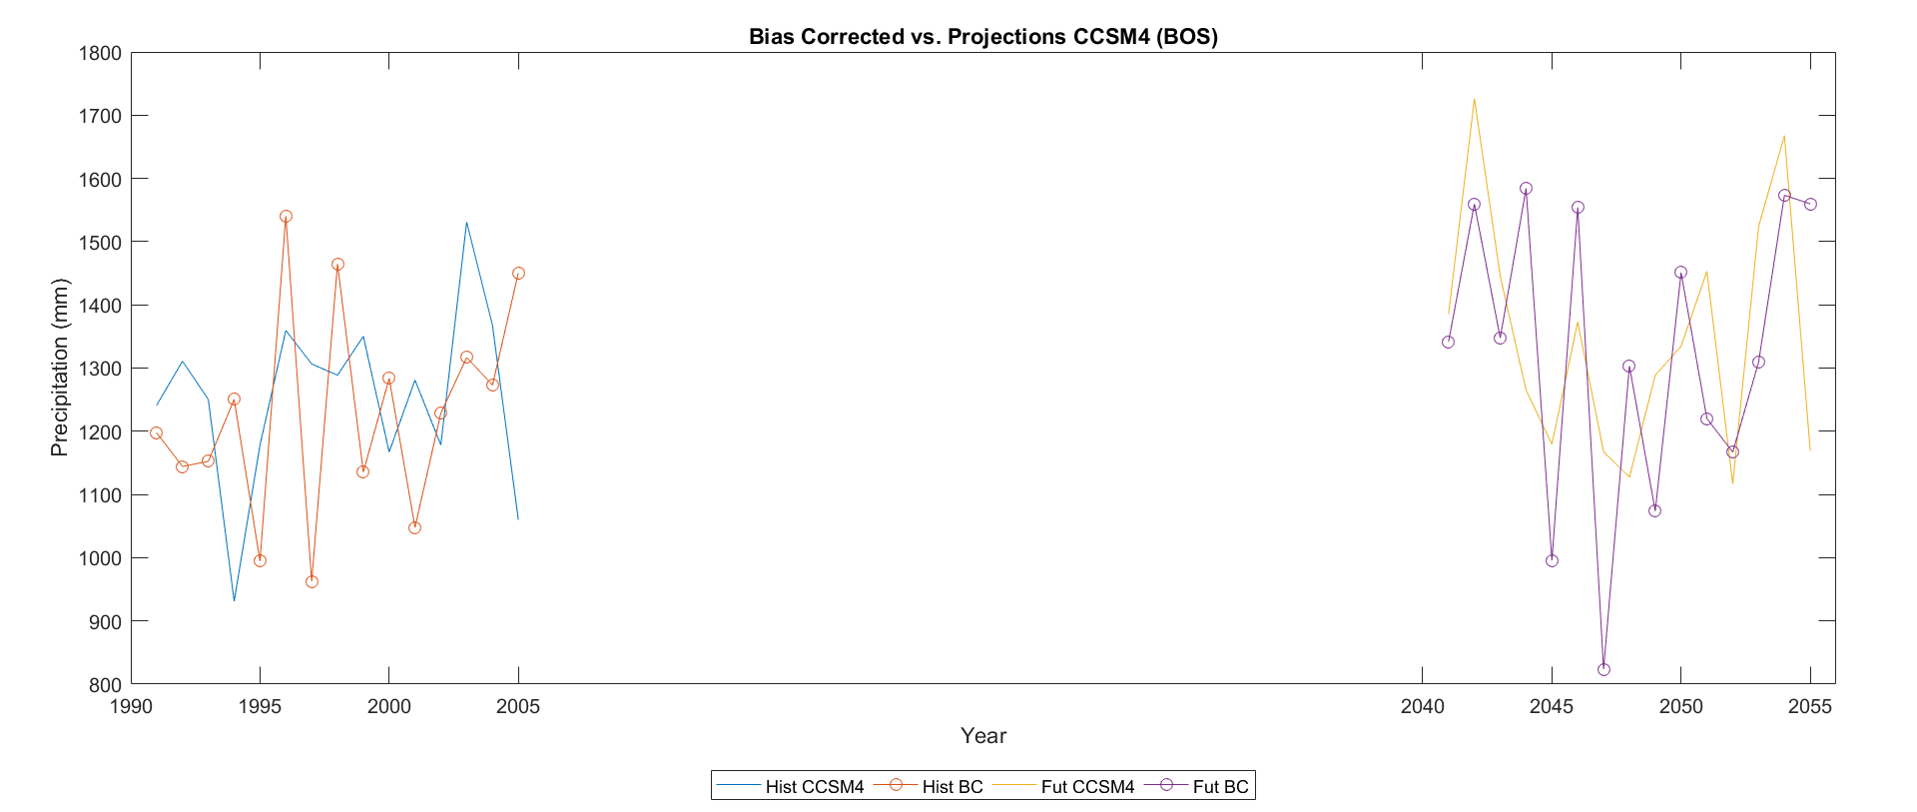
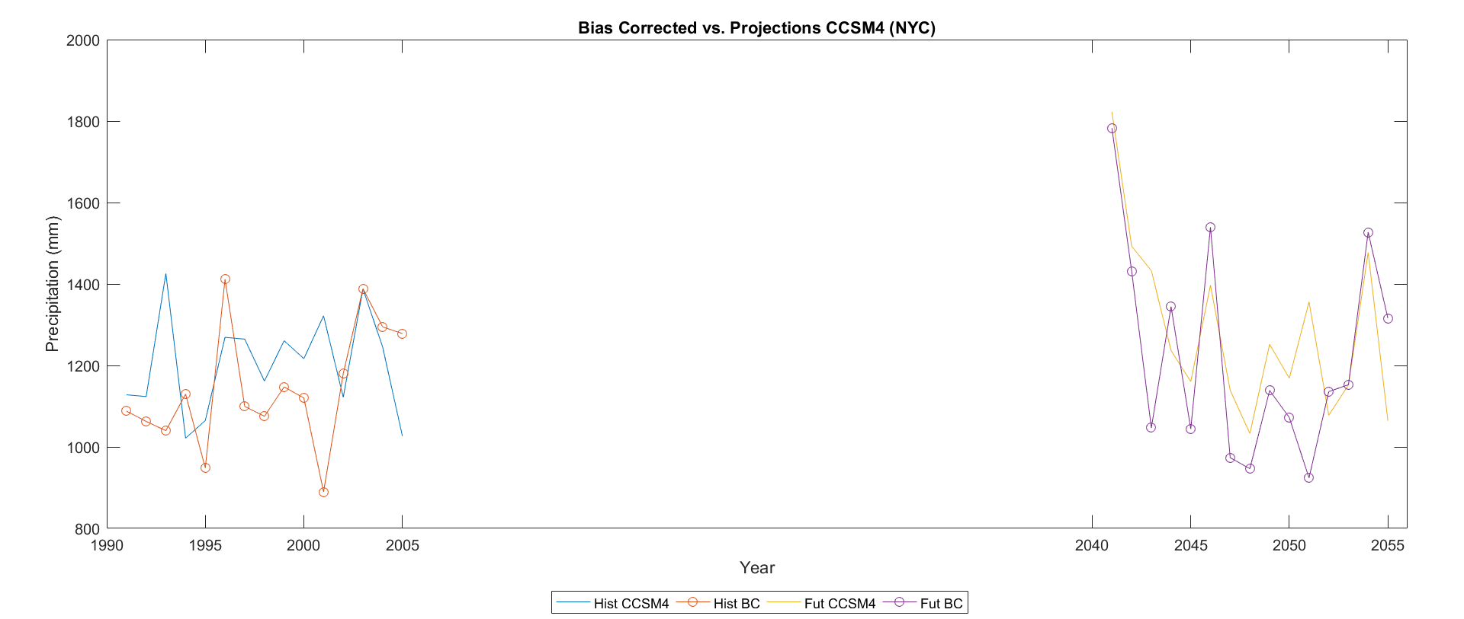

Slide 33
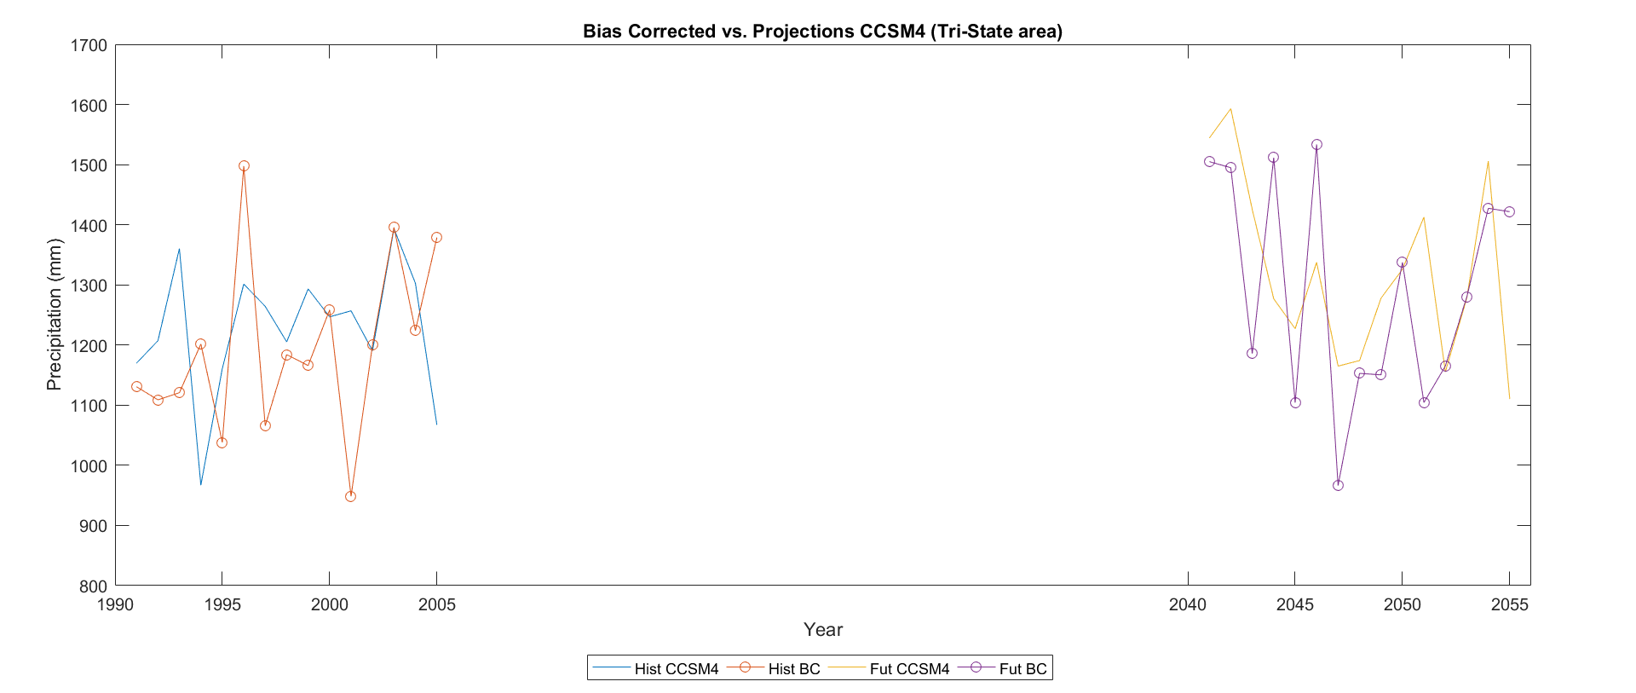
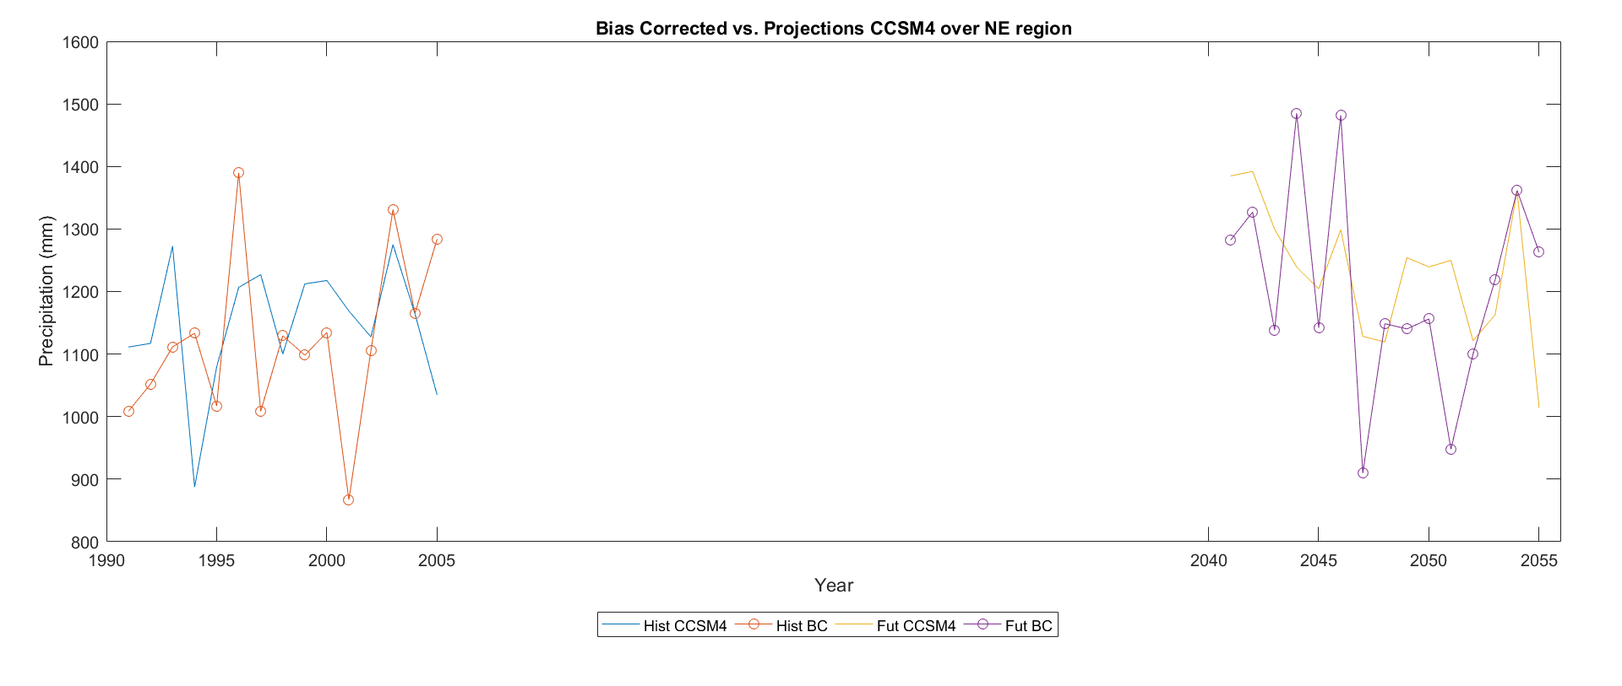

Slide 34
Key Results
How well are GCMs and RCMs able to capture individual events?

Slide 35
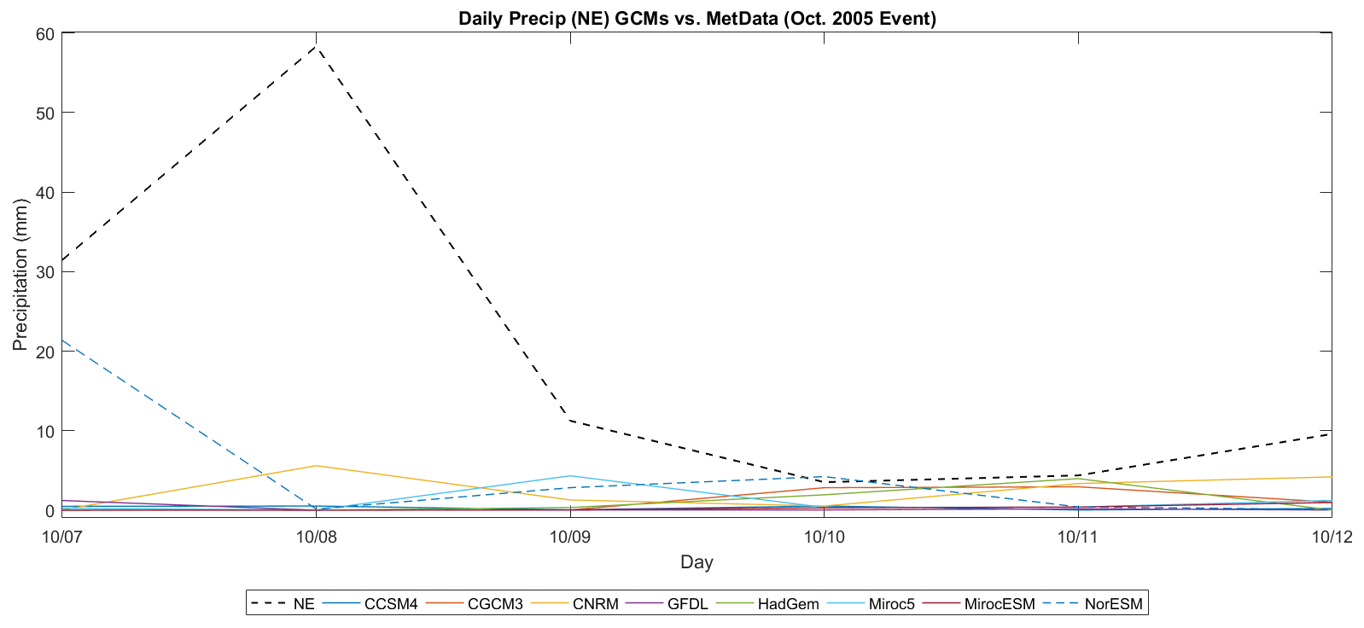

Slide 36
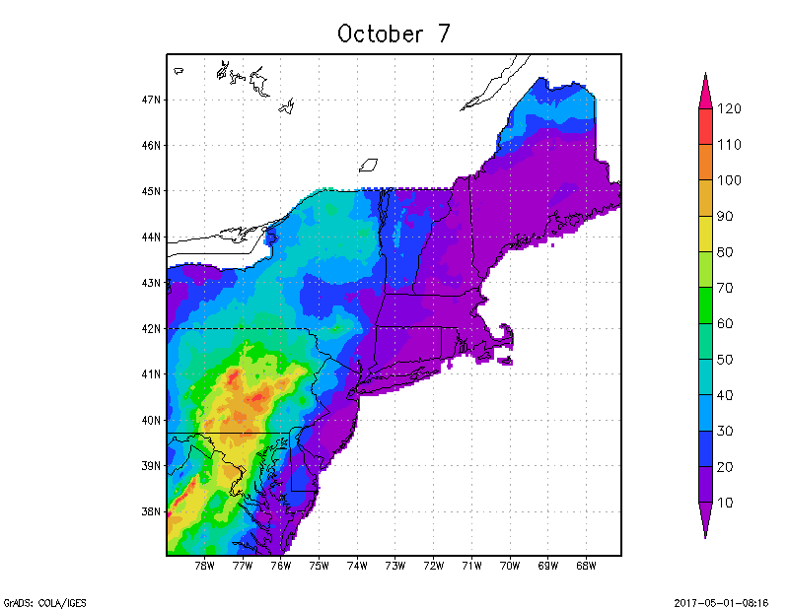
Observed (MetData)

Slide 37
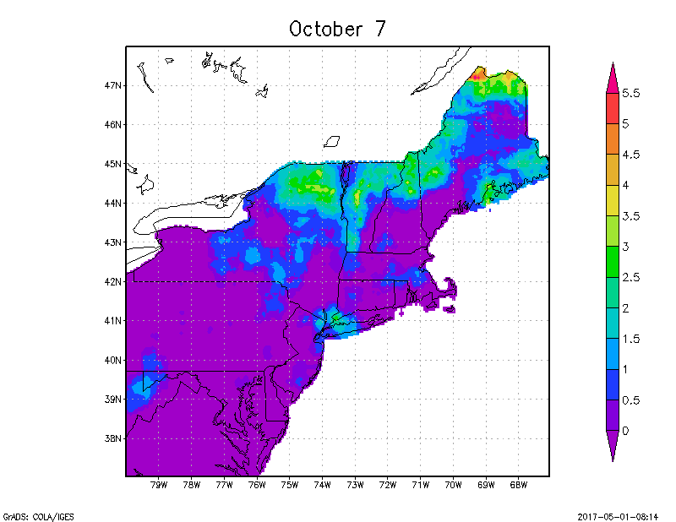
GCM output - CCSM4

Slide 38
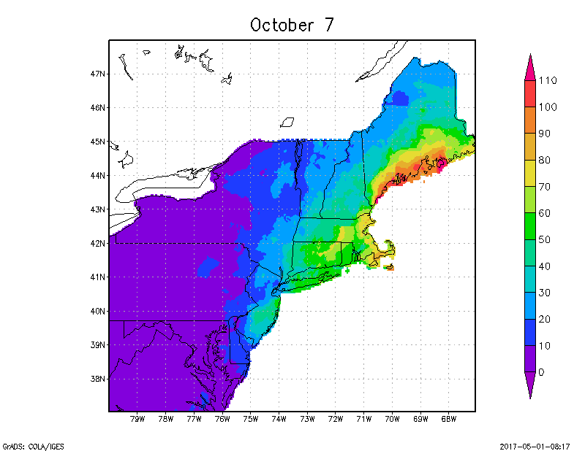
GCM output - NorESM

Slide 39
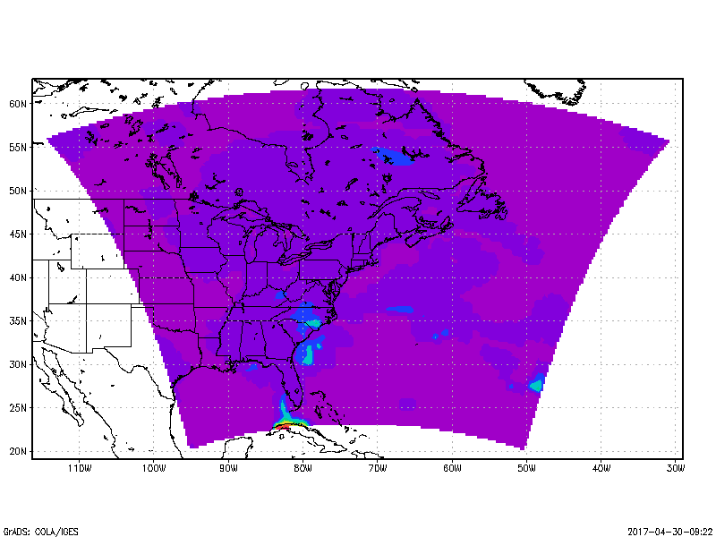
Full Domain RCM run centered on NYC
Atmospheric Model Output

Slide 40

Full Domain RCM run centered on NYC
Land Surface Model Output

Slide 41
Full Domain RCM run centered on NYC
Atmospheric Model Output
Land Surface Model Output

Slide 42
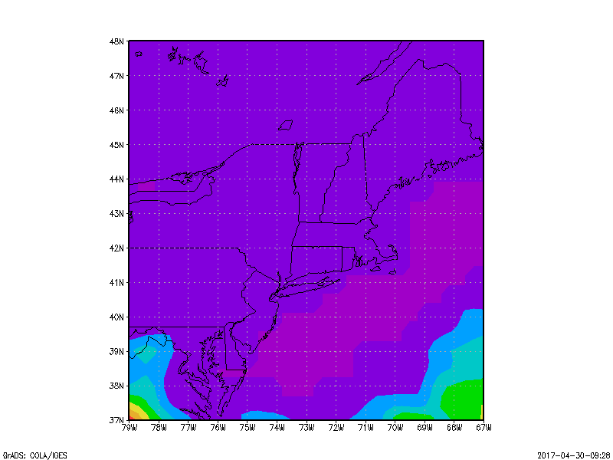
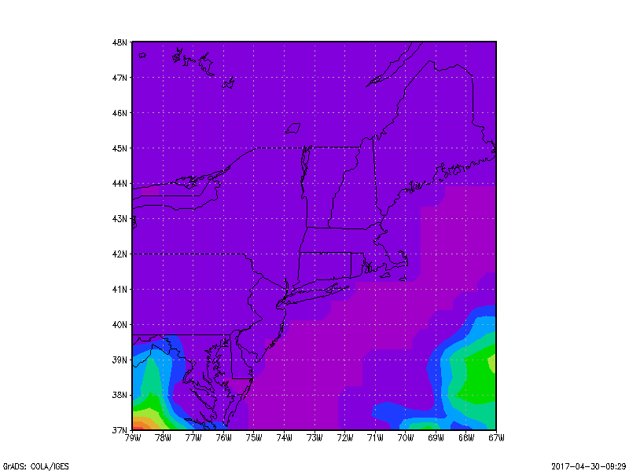
Northeast Region
Atmospheric Model Output
Land Surface Model Output

Slide 43
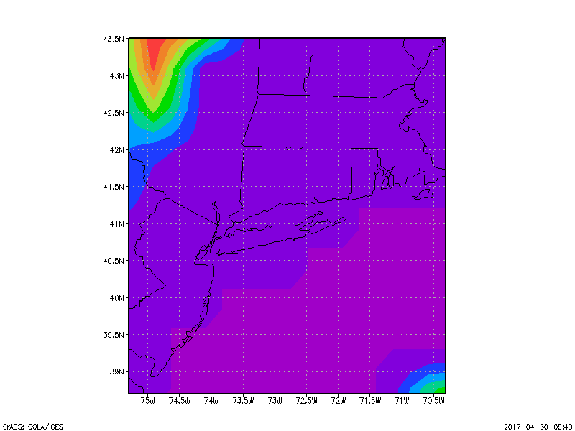
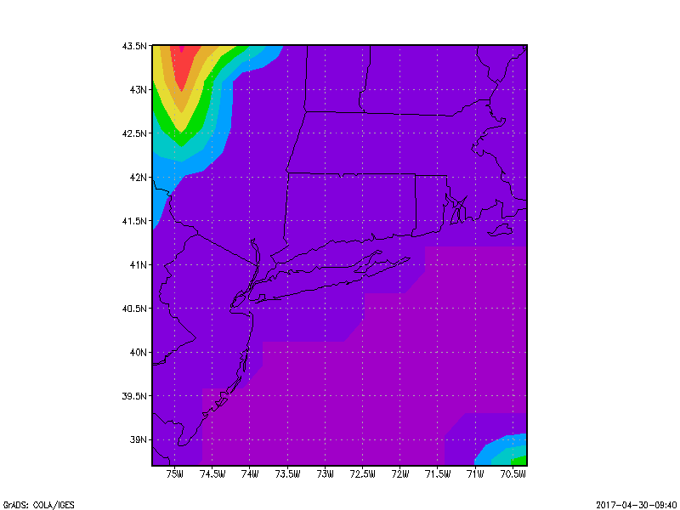
Tri-State Area
Atmospheric Model Output
Land Surface Model Output

Slide 44
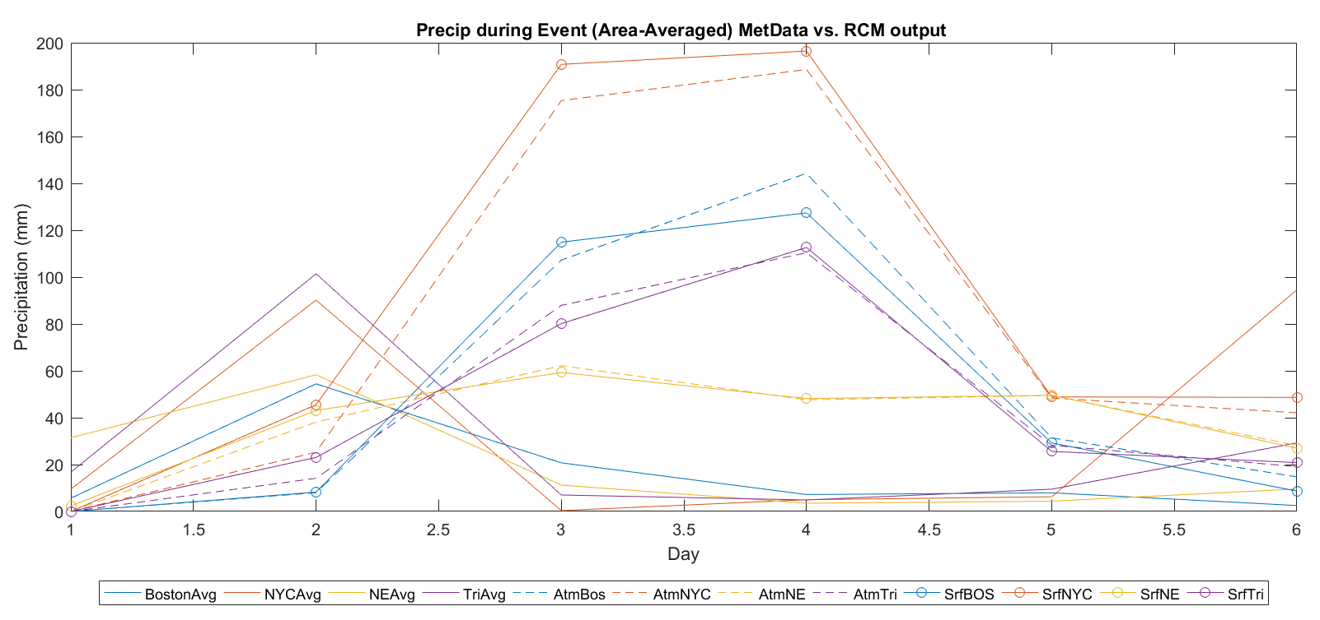

Slide 45
Challenges
Results not conclusive
Difference in domain size, boundary conditions, model uncertainties, resolution, missing data, etc.
Models are not particularly skillful at representing processes, especially in smaller domains like BOS and NYC
Interannual variability for precipitation is particularly difficult to model in the Northeast region and GCMs do not reflect observations very well
Attribution of changes in precipitation are difficult to quantify
Difficult to compare events at daily rather than hourly scale
So much to do, so little time

Slide 46
Conclusions and Further Research
There are some significant differences between annual averages of individual stations located throughout the Boston area, but not significantly different from the regional mean for the study domain
The Boston domain had higher annual precipitation on average compared to the other study domains from 1991-2005, but not a significant difference
The selected GCMs had some difficulty capturing the observed interannual precipitation variability for the study period (1991-2005)
It is unclear whether average annual precipitation is expected to increase overall for the Northeast region in the future
The RCM was better able to capture some of the observed precipitation during the October 2005 event.
More research needs to be done on the Northeast region in general for future precipitation extremes, as well as urban areas and whether or not they are expected to see increases in frequency and magnitude of precipitation in the future.

Slide 47
Supplementary Slides

Slide 48
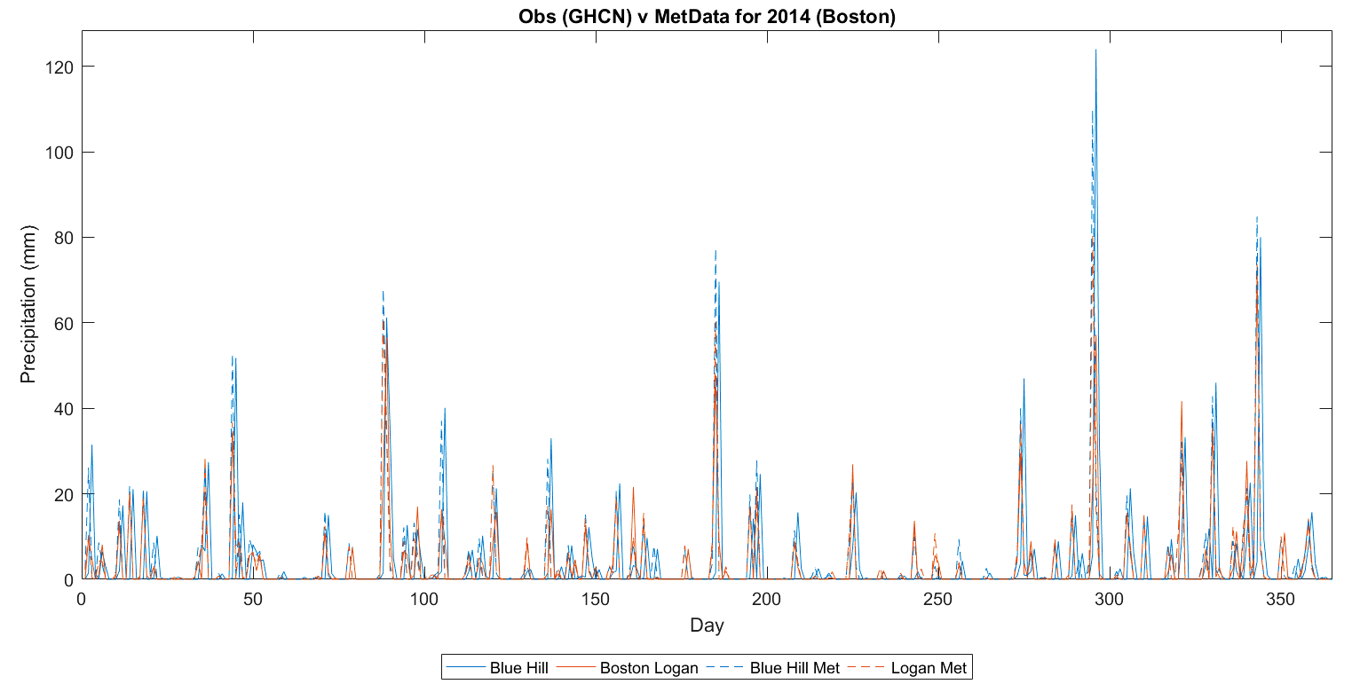

Slide 49
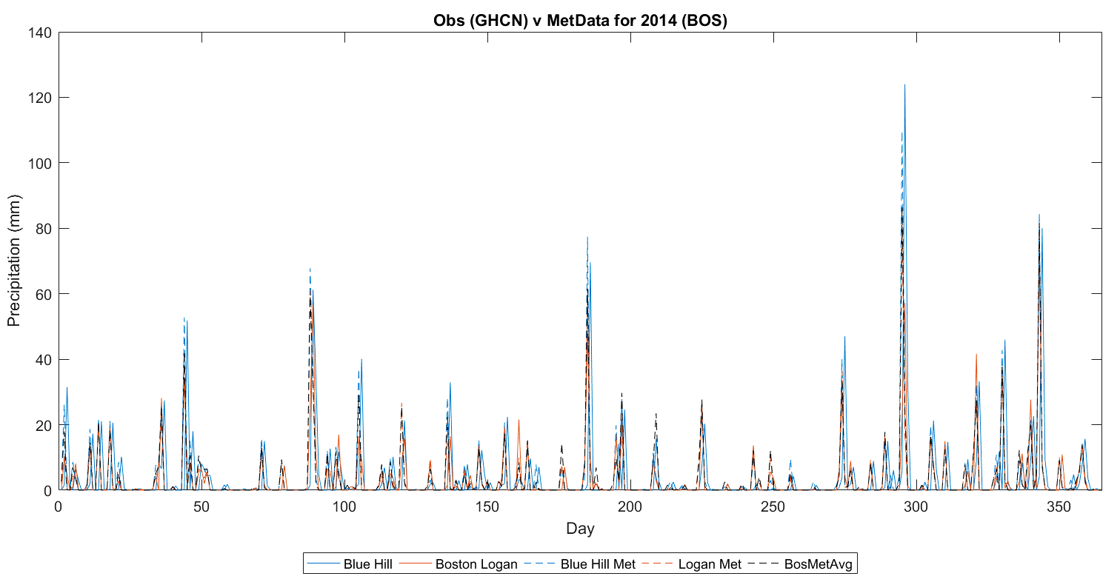

Slide 50
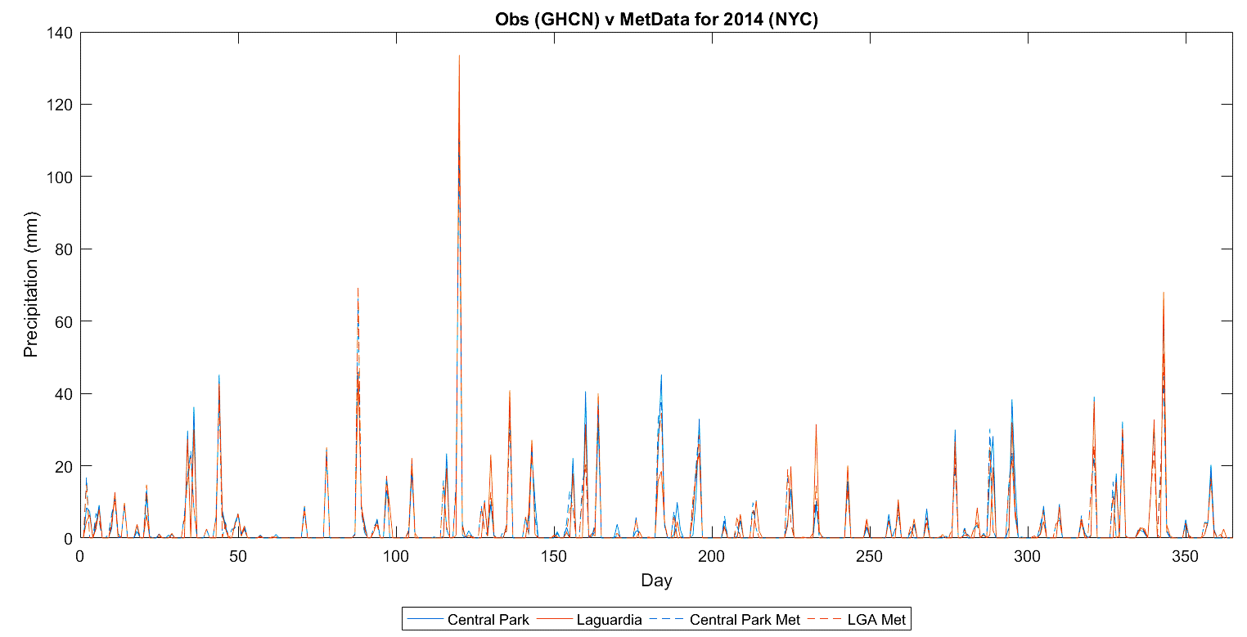

Slide 51
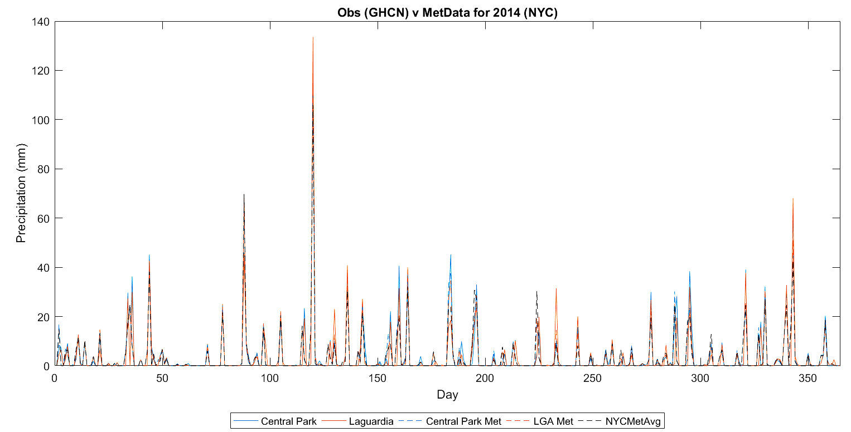

Slide 52
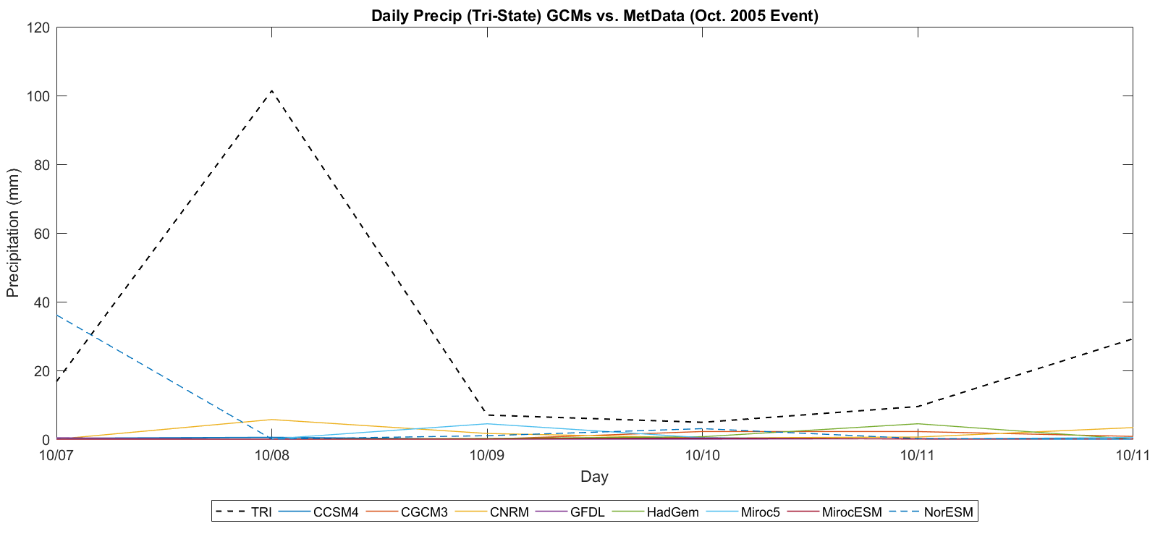

Slide 53
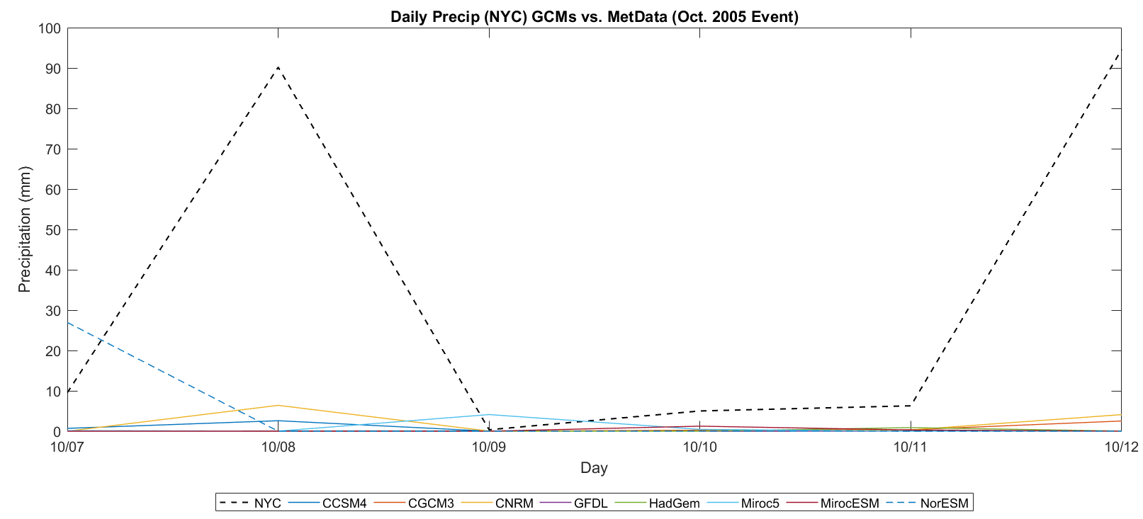

Slide 54
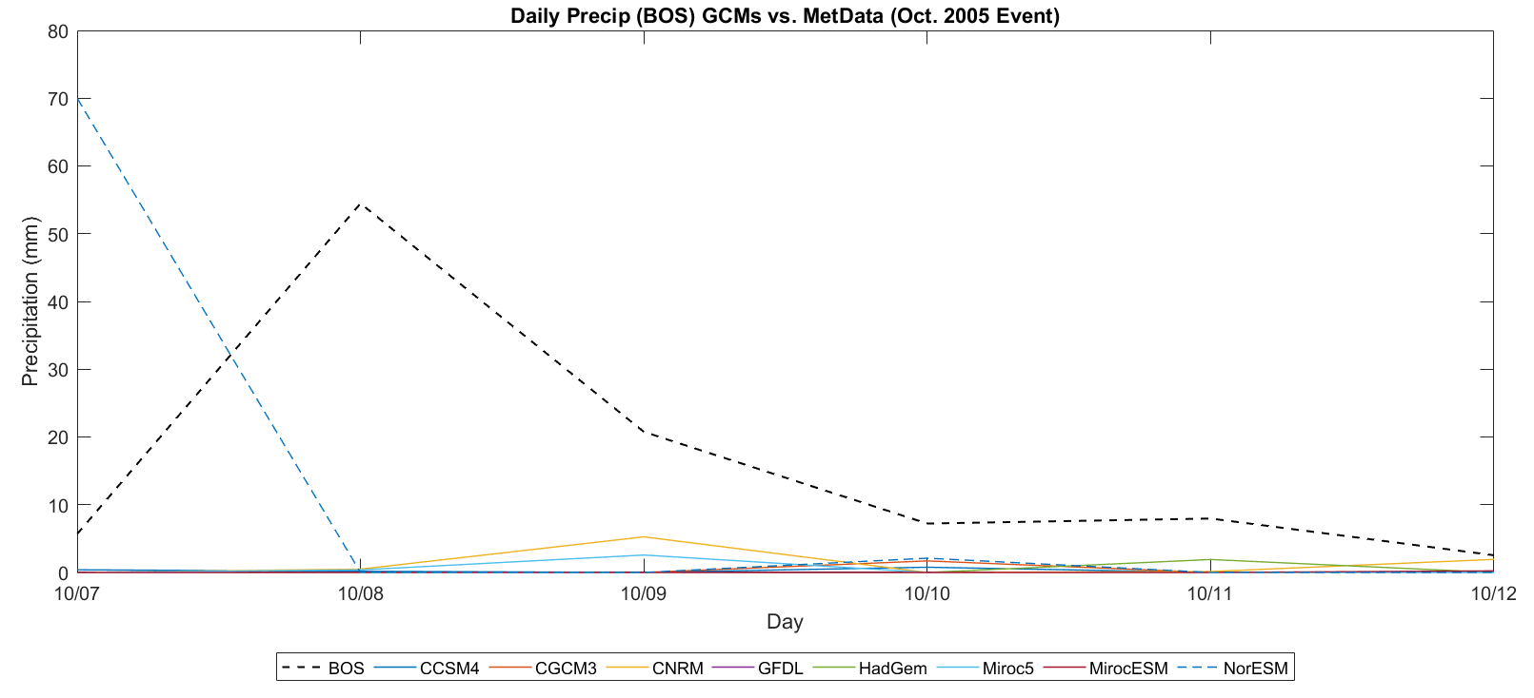

Slide 55
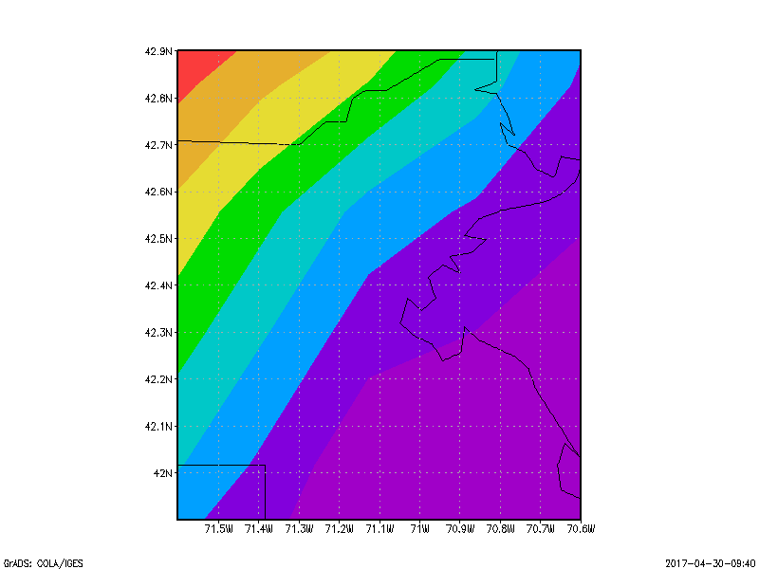

Boston
Atmospheric Model Output
Land Surface Model Output

Slide 56


NYC
Atmospheric Model Output
Land Surface Model Output

Slide 57





Slide 58


Slide 59





Slide 60


